Slide 1
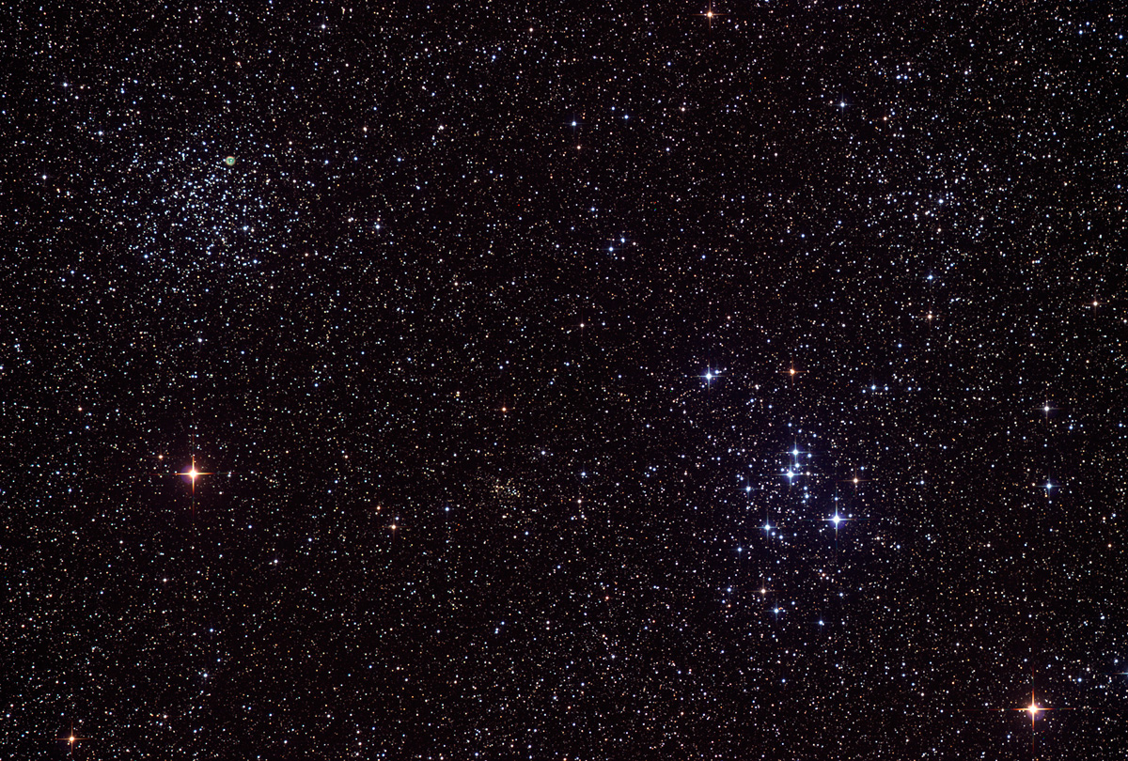

Astroschool:
Image Calibration
14
February 20th, 2014

Slide 2
Image Calibration
Why do we have to calibrate?
To remove unwanted signal and noise
Dark current
Read out signal/noise
Uneven field illumination (vignetting and dust donuts)
Notes:
Start with a quick discussion of how a CCD works. Talk about how the electrons build up in the wells as photons strike, and how dark current works, and about how the image is read off, causing the Bias signal.

Slide 3
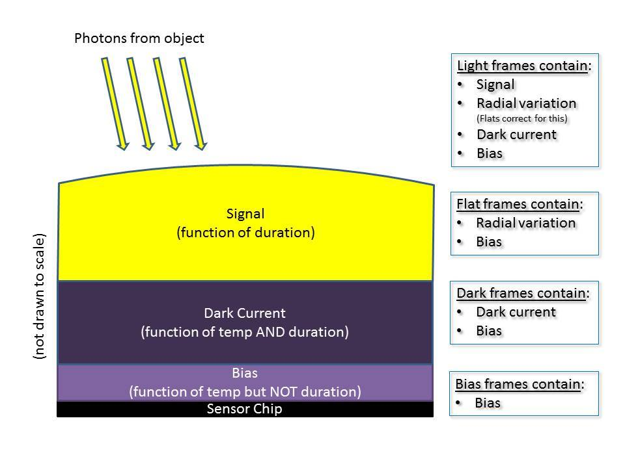
Image Calibration
Why do we have to calibrate?
Image credit: John Strong, iTelescope.net Facebook user group

Slide 4

Example bias frame
Notes:
Example bias frame

Slide 5
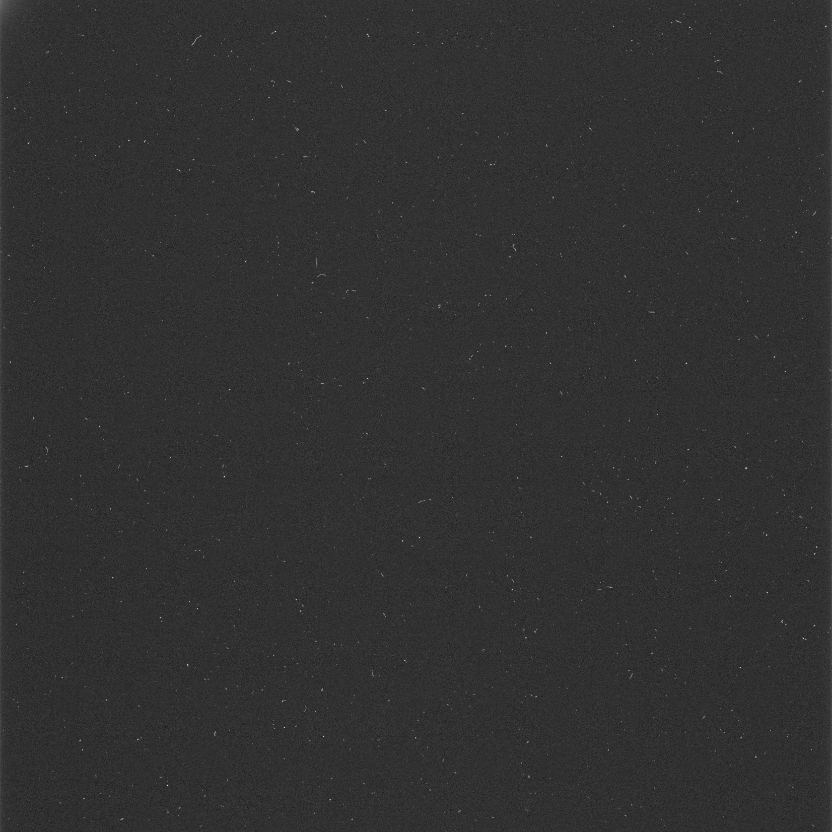
Example dark frame
Notes:
Example dark frame (15 minute exposure – note the amp glow in the upper left corner). Amp glow is caused by the high gain amplifier that reads out electrons from the CCD array and converts them to a voltage that can be read by the A/D converter.

Slide 6

Example flat frame
Notes:
Example flat frame (a good one)

Slide 7
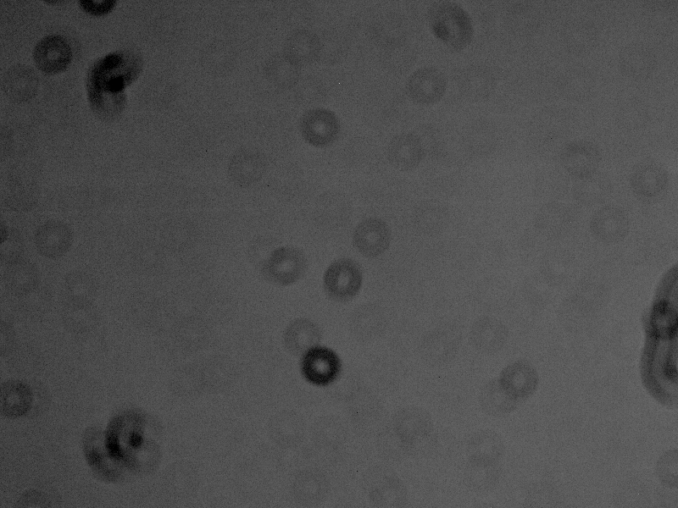
Example flat frame (dirty)
Notes:
Example flat frame (lots of dust donuts)

Slide 8
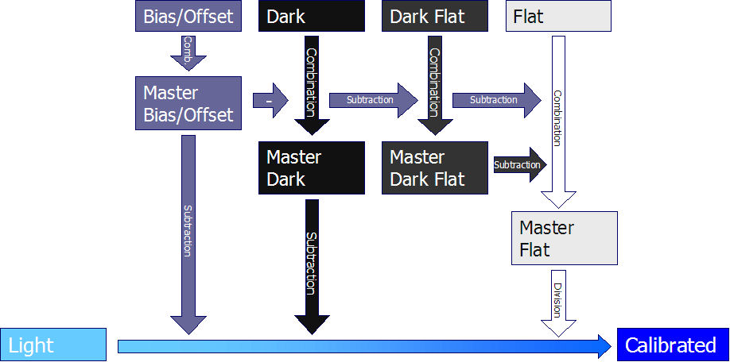
Image Calibration
Why do we have to calibrate?
Image source: http://deepskystacker.free.fr/english/theory.htm#CalibrationProcess

Slide 9
Taking Bias Frames
Bias frames are zero-length exposures with the shutter closed
(on a DSLR, use shortest exposure time your camera allows)
DSLR: use same ISO
So short in duration, dark current is negligible, so temperature is not important
Take a lot of Bias frames (I use 200)

Slide 10
Taking Dark Frames
Should be same duration as your light frames (DSLR – same ISO, too)
Cover the lens, or keep the shutter closed
Should be taken at same temperature as your lights
Take at least 10, but preferably 20-30

Slide 11
Taking Flat Frames
Shoot an evenly-illuminated field
Duration long enough to achieve 1/3 to ½ saturation of pixels
Same focus as your lights
DSLR –same ISO and f/ratio as lights, use Aperture Priority (Av)
Temperature not that important if exposures are fairly short
Take at least 10, but preferably 20-30
If using filters, take flats through each filter

Slide 12
Processing Bias and Dark Frames
Simply integrate (stack)
Average combine, no normalization or weighting
Reject outliers (hot and cold pixels, cosmic ray hits) using Winsorized Sigma clipping

Slide 13
Processing Flat Frames
Start by calibrating – subtract Master Bias
If you subtract Master Dark as well, then make sure the Master Bias is subtracted from the Master Dark first
Stack using average combine,
Multiplicative Normalization,
No weighting,
Pixel rejection: percentile clipping or Winsorized Sigma Clipping,
Equalize fluxes

Slide 14
Calibrating light frames
For each light frame:
Subtract Master Bias
Subtract Bias-subtracted Master Dark
Apply Master Flat (divide light by normalized Master Flat)

Slide 15
Registering light frames
Registration involves aligning each light frame to a reference frame based on the stars in the image.
Be very particular in choosing your reference frame. Choose one with the tightest stars (best focus and seeing). Look at image statistics, like FWHM and eccentricity.
PI: Blink, Image statistics, SubframeSelector script, StarAlignment

Slide 16
Integrating light frames
Image Integration (stacking) involves creating a light master from your individual frames.
Use Average combination
Reject pixels using Winsorized Sigma clipping (if enough sub frames)
In PI, you pick a reference frame for weighting; choose one with best SNR and no artifacts (planes, cosmic ray strikes, etc.)
PI: Blink, SubframeSelector, ImageStatistics, ImageIntegration

Slide 17
Calibration software
PixInsight: ImageCalibration, ImageIntegration, StarAlignment, BatchPreProcessing
CCDStack
Deep Sky Stacker
IRIS
Maxim DL

Slide 18
Calibration links
Understanding Read Noise:
http://qsimaging.com/ccd_noise.html
PixInsight master calibration frames tutorial:
http://pixinsight.com/tutorials/master-frames/en.html
PI BatchPreProcessing tutorial:
http://www.harrysastroshed.com/Calibration.html
Deep Sky Stacker tutorial:
http://deepskystacker.free.fr/english/theory.htm

